Slide 1
DATA ANALYSIS PROJECT USING SQL
BY Aarti Choudhary

Slide 2
REGULATORY AFFAIRS OF ROAD ACCIDENTS DATA -2020
Road safety is a major issue in urban India, especially in large cities with heavy traffic. Studying road accidents data helps us understand the main causes of accidents, their outcomes, and differences across cities. This project focuses on analyzing accidents causes and subcategories , with special attention to minor injury cases. The insights from the study can help authorities plan better , data-driven road safety measures.
- By Aarti Choudhary

Slide 3
PROJECT OVERVIEW
This project aims to analyze the distribution of incidents across various cities, focusing only on those where the count exceeds 15 cases. By filtering and ranking cities based on their incident frequency, we can identify areas with a higher occurrence of minor injuries and assess the underlying factors contributing to these accidents. Understanding these patterns is essential for recognizing high-risk urban zones and addressing road safety concerns effectively.
Using SQL-based data analysis, the project extracts meaningful insights from road accident records, categorizing incidents by city and cause. This structured approach allows us to pinpoint cities with frequent minor injury cases and examine which cause categories are most prevalent. The findings can help policymakers, traffic authorities, and urban planners develop targeted safety measures to reduce road accidents and improve overall traffic management.

Slide 4
TECHNOLOGY USED
This project primarily utilizes SQL for querying and analyzing road accident data. SQL is used to extract meaningful insights by filtering, grouping, and ranking cities based on the number of incidents. Various SQL functions such as COUNT(), GROUP BY, ORDER BY, and conditional filtering help in identifying trends related to minor injuries across different cities. Through these queries, we can determine which cities report the highest number of minor injury incidents and analyze the contributing factors.
Additionally, Excel is used for an initial overview of the dataset, specifically to check the structure and available columns. This helps in understanding the data before writing SQL queries for analysis. Lastly, PowerPoint is utilized to present findings in a visually structured format, making it easier to communicate insights, trends, and recommendations effectively. By leveraging these technologies, the project ensures a systematic approach to data analysis and presentation.

Slide 5
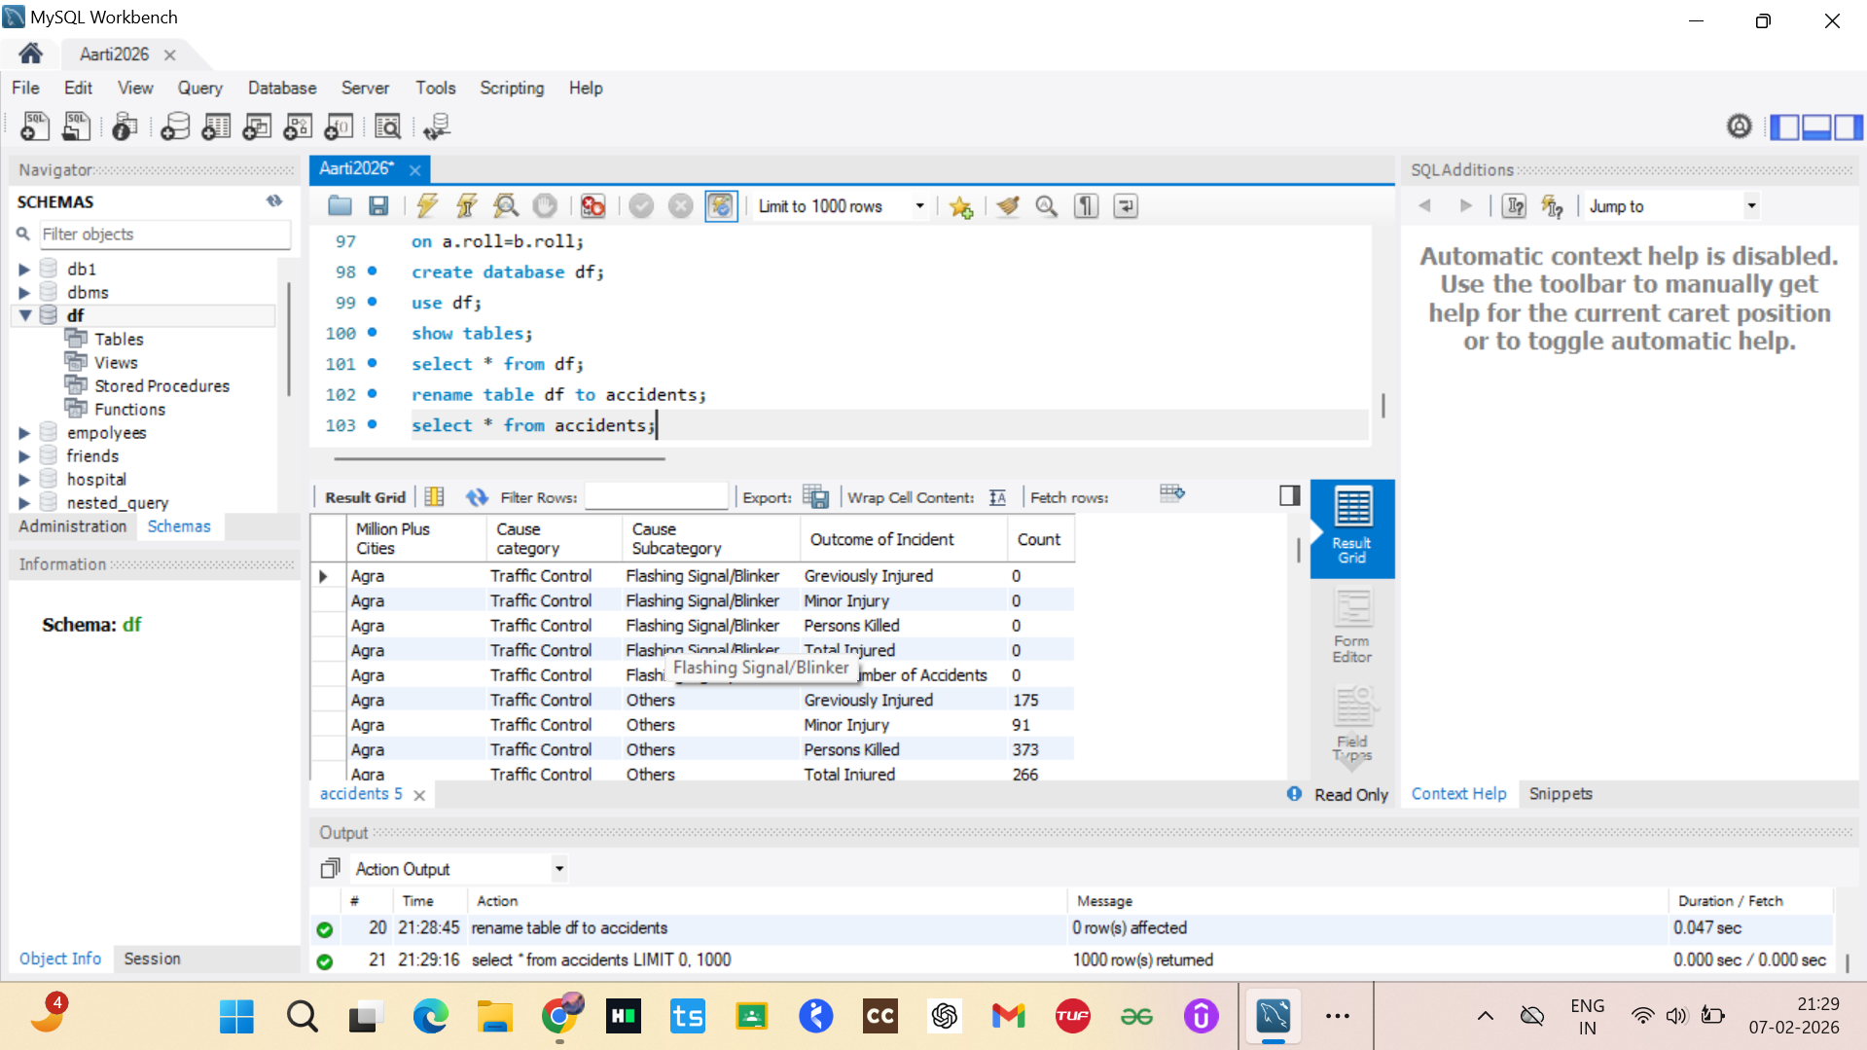

QUIRES 1] Import & View Table
create database df;
use df;
show tables;
select * from df;

Slide 6
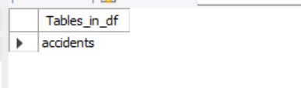
2] Rename The Table
rename table df to accidents;
select * from accidents;
show tables;

Slide 7
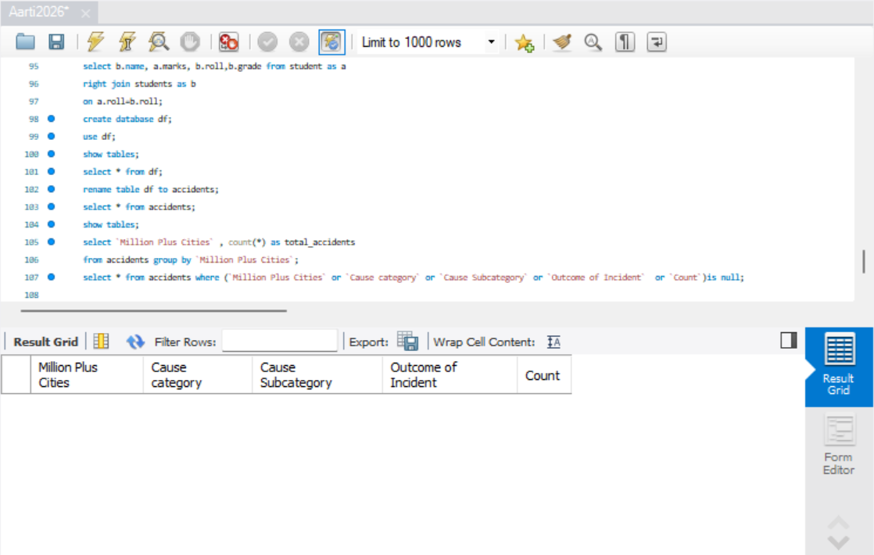
4] Check Null Values
select `Million Plus Cities` ,
count(*) as total_accidents from accidents
group by `Million Plus Cities`;
select * from accidents where `Million Plus Cities` or `Cause category` or `Cause Subcategory` or `Outcome of Incident` or `Count` is null;

Slide 8
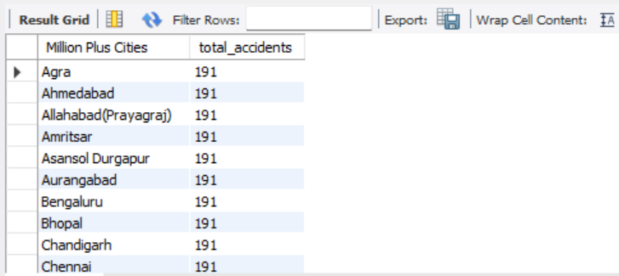
5] Top Cities with the Highest Incident Count
SELECT `Million Plus Cities`,
COUNT(*) AS total_accidents
FROM accidents
GROUP BY `Million Plus Cities`
ORDER BY total_accidents DESC

Slide 9
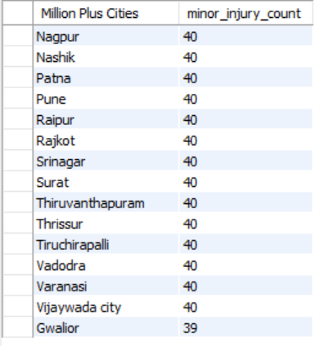
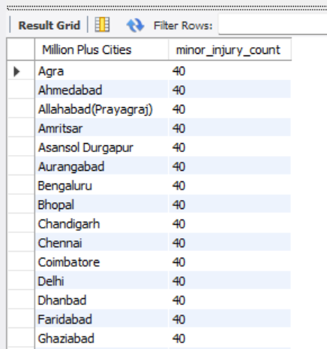
6] Distribution of "Minor Injury" Incident Outcomes Across Cities (Greater Than 15)
SELECT `Million Plus Cities`,
COUNT(*) AS minor_injury_count FROM accidents
WHERE `Outcome of Incident` = 'Minor Injury’
GROUP BY `Million Plus Cities`
HAVING COUNT(*) > 15
order by minor_injury_count desc;

Slide 10
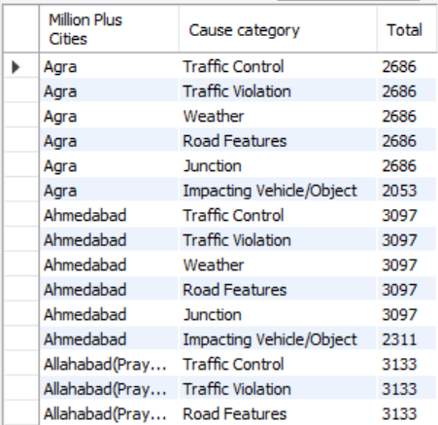
7] Top Cities for Each Specific Cause Category
select `Million Plus Cities` , `Cause category`, sum(count) as Total
FROM accidents
group by `Million Plus Cities` , `Cause category`
order by `Million Plus Cities`,
Total desc
Limit 5;

Slide 11
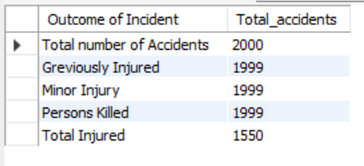
Most common outcome across all cities
select `Outcome of Incident` ,
count(*) as Total_accidents
from accidents
group by `Outcome of Incident`
order by Total_accidents desc;

Slide 12
City-wise distribution of accidents caused
select `Million Plus Cities` , `Cause category`, sum(count) as Total FROM accidents
group by `Million Plus Cities` , `Cause category`
order by `Million Plus Cities`,Total desc;

Slide 13
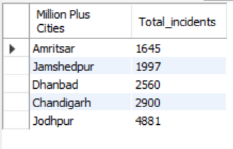
Cities with lowest number of accidents
select `Million Plus Cities` ,sum(count) as Total_incidents
from accidents
group by `Million Plus Cities`
order by Total_incidents asc
limit 5;

Slide 14
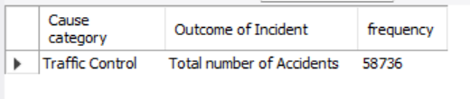
Most frequent outcome-cause PAIR
select `Cause category`,`Outcome of Incident`,
sum(count) as frequency from accidents
group by `Cause category`,`Outcome of Incident`
order by frequency desc
limit 1;

Slide 15
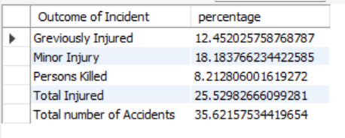
PERCENTAGE OF EACH OUTCOME TYPE
select `Outcome of Incident`,
sum(count)*100/(select sum(count) from accidents) as percentage
from accidents
group by `Outcome of Incident`;

Slide 16
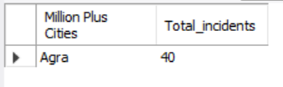
CITY WITH HIGHEST ACCIDENT FOR A SPECIFIC CAUSE CATEGORY
select `Million Plus Cities`, count(*) as Total_incidents
from accidents where `Cause category` is not null
group by `Million Plus Cities`,`Cause category`
order by Total_incidents desc limit 1;

Slide 17
ANALYSIS APPROACH
The analysis was carried out using SQL aggregation and grouping techniques on pre aggregated accident data. Since the dataset already contained summarized incident counts, functions such as SUM(Count) were used instead of record counting. City wise, cause identify high-- wise, and outcome level based queries were executed to risk cities, dominant accident causes, and frequently occurring outcomes. Special attention was given to minor injury cases, as they represent recurring safety issues that often go underreported compared to fatal accidents.

Slide 18
KEY INSIGHTS
Major metropolitan cities such as Delhi, Mumbai, and Bengaluru report the highest number of accident incidents, indicating a strong correlation between traffic density and accident frequency. • Cities like Coimbatore, Trichy, and Gwalior show comparatively lower accident counts, suggesting relatively safer traffic conditions or lower vehicle density. • Minor Injury emerges as the most common outcome across all cities, accounting for the majority of reported incidents, while fatal and grievous injury cases form a smaller proportion
Over Speeding and Drunken Driving are among the most frequently reported accident causes across multiple cities, highlighting behavioral factors as key contributors to road accidents. City wise analysis reveals that different cities exhibit different dominant causes; for example, overspeeding is more prominent in larger metros, whereas other causes appear more evenly distributed in smaller cities. • During analysis, it was observed that certain city could not be derived due to level cause combinations limitations in data granularity importance of structured and detailed data collection.

Slide 19
SUMMARY
This project successfully analyzed regulatory road accident data using SQL to identify city wise accident trends, dominant causes, and outcome distributions. By focusing on aggregated data, the study efficiently highlighted high risk cities and recurring minor injury cases that require regulatory attention. The findings emphasize the importance of targeted road safety measures rather than uniform policies across cities. Overall, the structured SQL based analysis demonstrates how data driven insights can assist traffic authorities and policymakers in improving urban road safety planning and decision making.

Slide 20
THANKYOU

